Slide 1
Google Play Store Ratings
Presented by: Joey Tuason Last Updated: May 11, 2022

Slide 2


Hello!
I am Joey Tuason
I am here because I love to visualize data.
You can find me at:
https://joeytuason83.github.io/

Slide 3

Table of Contents
Google Play Store Ratings
Problem Statement
The Story
Insights
Appendix

Slide 4
1.
Problem Statement
What we will discuss about

Slide 5
What key notes can we see by observing ratings in order to develop an app with likely high rating?

Slide 6
2.
The Story
Let the plots tell the plot.

Slide 7
1,230,299
🔨removed 0 and NA ratings!
2,312,944
Apps from Google Play Store

Slide 8
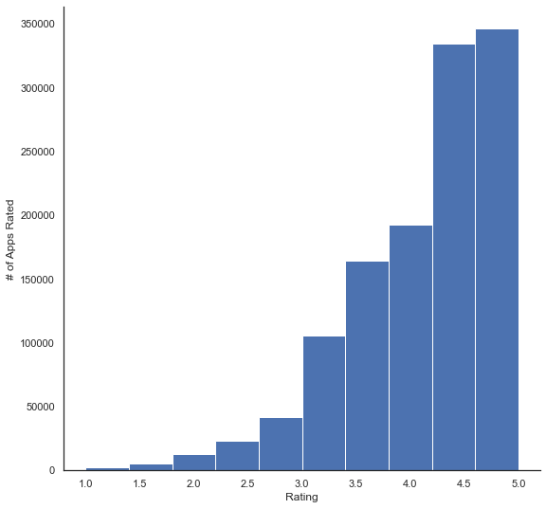
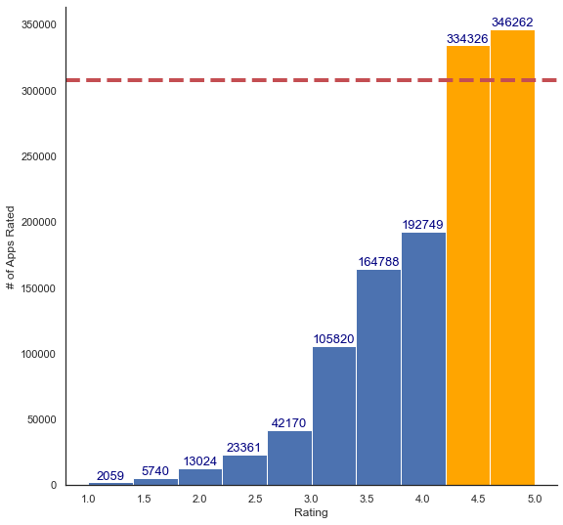
Overview on Mean App Ratings
25% of the dataset
At least 50% of released apps are above 4.5 stars

Slide 9
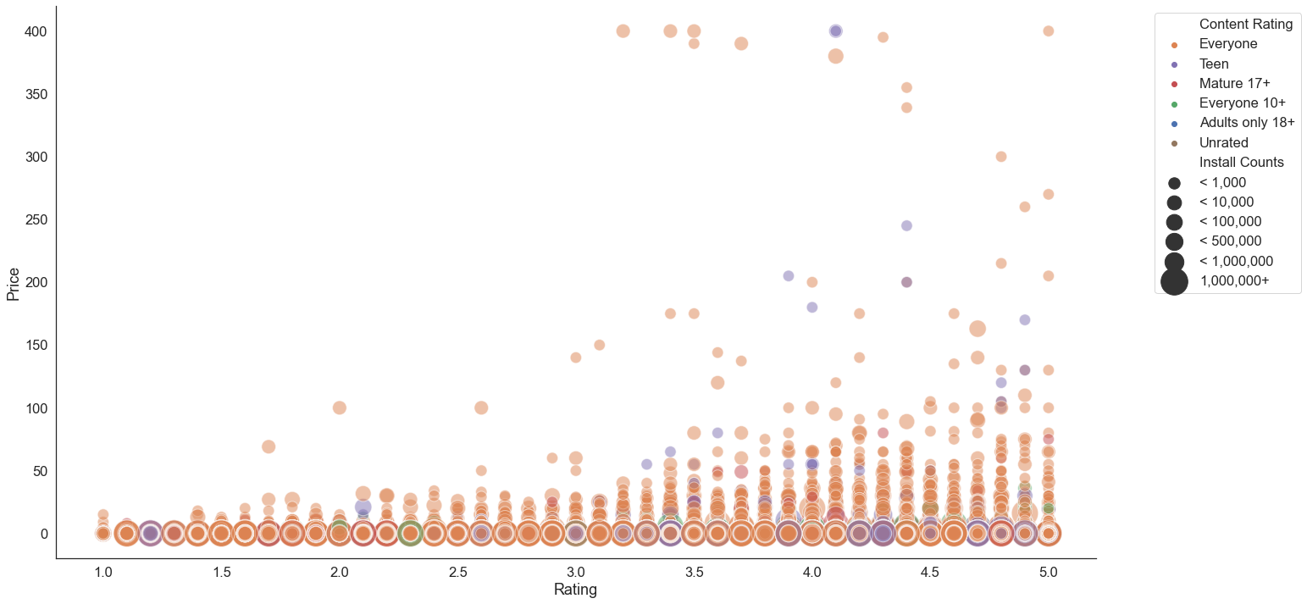
Ratings and Price Correlation Content Rating and Install Counts
0.33%
Low Correlation
Teen category rating feels ‘less risky’

Slide 10
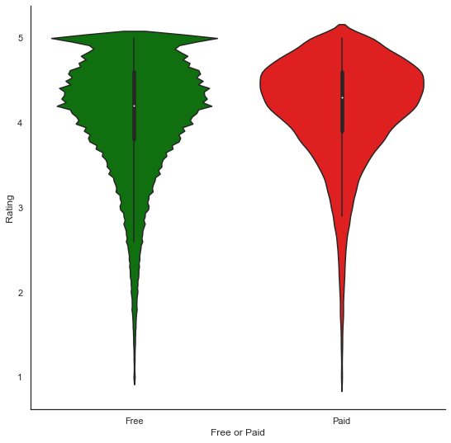
Free and Paid App Ratings
Paid app median rating better than free app
Free apps see spike near five star rating

Slide 11
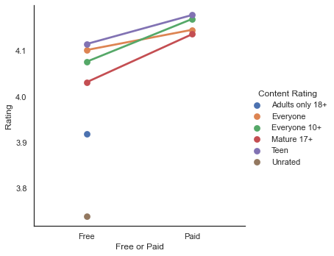
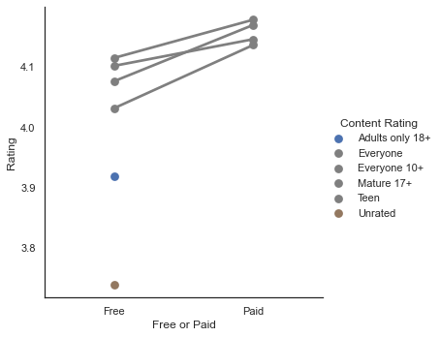
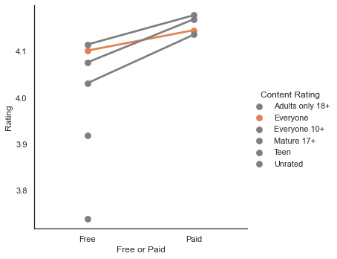
Content Rating: Free vs Paid
Paid versions have higher rating impact than the Free
Adults only 18+ and Unrated do not have paid apps
Everyone not as significant

Slide 12
3.
Insights
In summary…

Slide 13
Conclusions
1
At least 50% of released apps are above 4.5 stars
2
Ratings have low correlation whether the app is free or not
3
Teen category apps might be worth the gamble

Slide 14
Conclusions
4
Paid versions have higher rating impact than the Free
5
Adults only 18+ and Unrated do not have paid apps
6
Everyone not as significant

Slide 15
4.
Appendix
For your reference

Slide 16
List of references:
Dataset: OpenML | Github | Kaggle
Notebook (2nd commit)

Slide 17
Thanks!
Any questions?
You can find me at:
@joeytuason83 & joeytuason@gmail.com

